Slide 1

Senior Design Project
End Term Presentation
Lightweight Hybrid CNN for Real-Time Image Dehazing with Perceptual Loss Optimization
Supervised By: Dr. Subhashree Subudhi
Group No.: F12
Debi Prasad Mahakud: 2141013002
Sai Pritam Panda: 2141016050
Hrishikesh Swain: 2141019406
Prabhat Kumar Sharma: 2141019275
Department of Computer Sc. and Engineering
Faculty of Engineering & Technology (ITER)
Siksha ‘O’ Anusandhan (Deemed to be) University
Bhubaneswar, Odisha
1

Slide 2
Presentation Outline
Introduction
Project Overview & Problem Statement
Objectives & Motivations
Background & Literature Review
Existing Solutions & Their Limitations
Improvements Over Existing Solutions
Proposed Solution & Architecture
Schematic Layout
Architecture
Key Features & Modules
Implementation Details
Technologies, Frameworks and Libraries Used
Results and Analysis
Test Results – System Outputs and Screenshots
Performance Metrics and Interpretation of Results
Conclusion & Future Work
Key Findings
Scope for Improvement
Bibliography
2

Slide 3
Introduction
Project Overview
Goal: To design and implement a deep learning model that enhances the quality of hazy images by effectively removing fog, mist, or haze, thereby improving visibility and clarity for critical applications such as autonomous driving, surveillance, and remote sensing.
Real-time Application:
Enhancing visibility for self-driving cars
Improving the clarity of CCTV footage
Enhancing real-world visuals in AR/VR applications
3

Slide 4
Contd…
Problem Statement & Motivations
Problem Statement: Hazy or foggy images degrade the visibility of important details and affect image quality, making tasks like object detection, image recognition, and navigation more challenging.
Motivation:
Limitations of Existing Dehazing Methods:
Struggle with real-time processing.
Require high computational power.
Fail to preserve perceptual image quality.
Proposed Solution:
Leverage lightweight models for real-time performance.
Loss functions are used to mimic human visual perception for enhanced clarity.
4

Slide 5
Contd…
Objectives & Expected Impact
Objectives:
Develop a lightweight hybrid CNN model for real-time image dehazing.
Optimize the model using perceptual loss to maintain visual quality.
Test the model on hazy image datasets to evaluate performance.
Expected Impact: The approach will lead to faster, more efficient image dehazing solutions, with potential applications in various fields like autonomous vehicles, surveillance, and photography.
5

Slide 6
Background & Related Work
Table 1 - Existing Solutions and Their Limitations
Sl. No | Title | Year | Methods Used | Research Gap
1 | Dark Channel Prior | 2009 | Dark channel prior, atmospheric scattering model, soft matting for transmission refinement | Struggles with sky regions and bright objects; computationally intensive; lacks learning-based adaptability
2 | DehazeNet: An End-to-End System for Single Image Haze Removal | 2016 | CNN, Maxout units for feature extraction, BReLU activation, transmission map estimation | Inaccurate atmospheric light estimation; relies on synthetic data; limited generalization to real-world Haze
3 | AOD-Net: All-in-One Dehazing Network | 2017 | End-to-end CNN, reformulated atmospheric scattering model, joint optimization of parameters | Limited handling of dense haze; lacks attention mechanisms; may lose fine details in complex scenes
4 | FFA-Net: Feature Fusion Attention Network for Single Image Dehazing | 2020 | CNN, Feature Attention (Channel + Pixel), multi- scale feature fusion | High computational complexity; limited focus on real-time applications; synthetic data dependency
6

Slide 7
Contd…
Table 2 - Existing Solutions and Their Limitations
Sl. No | Title | Year | Methods Used | Research Gap
5 | ODD-Net: A Hybrid Deep Learning Architecture for Image Dehazing | 2024 | CNN, Atmospheric Light Net (A Net) with dilated convolution, hybrid architecture | Requires extensive datasets; computational overhead; limited evaluation on diverse real-world conditions
6 | Image Dehazing Based on Cascaded Multi-scale CNN (CMTnet) | 2023 | Two-stage CNN, A-Est for atmospheric light, cascaded multi-scale CNN for transmission Refinement | Neglects uneven haze distribution; high computational cost; limited adaptability to non-homogeneous haze
7 | TheiaNet: Towards Fast and Inexpensive CNN Design Choices for Image Dehazing | 2023 | End-to-end CNN, multi-cue color space analysis, lightweight architecture | Limited exploration of dense haze; lacks advanced attention mechanisms; synthetic data bias
8 | URNet: A U-Net Based Residual Network for Image Dehazing | 2022 | CNN, U-Net with residual blocks, hybrid convolution (standard + dilated) | Inaccurate atmospheric light estimation; moderate complexity; limited performance on dense haze
7

Slide 8
Contd…
Related Work & Their Limitations
Traditional Methods:
Dark Channel Prior (DCP), Retinex-based methods, and Physical models that use atmospheric scattering models.
Limitations: Computationally expensive, require multi-stage processing, and fail to preserve texture and fine details.
Deep Learning-based Methods:
CNN-based dehazing approaches like DehazeNet, AOD-Net, and others.
Limitations: High computational cost, large models, and poor real-time performance.
Improvements Over Existing Solutions
Hybrid CNN: A hybrid model provides an efficient architecture with reduced computational requirements.
Perceptual Loss Optimization: This approach enhances perceptual quality by optimizing the model to focus on human visual perception metrics rather than pixel-wise accuracy alone.
Improvements Over Existing Solutions
8

Slide 9
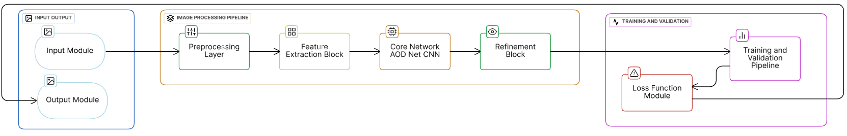
Proposed Solution & Architecture
Schematic Layout
9

Slide 10
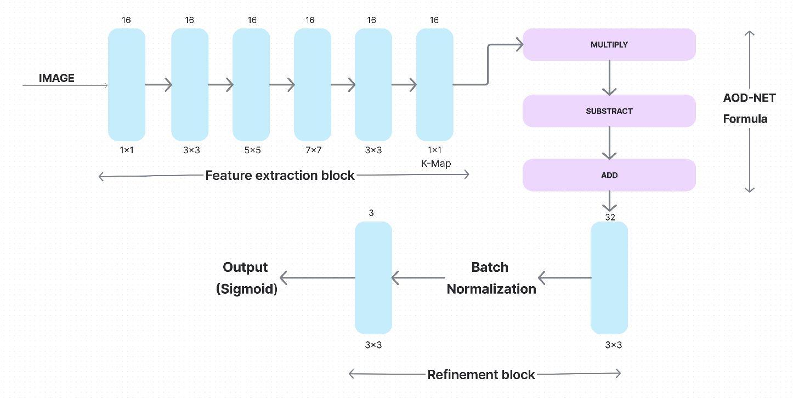
Contd…
Architecture
AOD Net Formula:
J(x) = K(x)*I(x) – K(x) + 1
Where,
J(x) – Model’s Dehazed Image
K(x) – Feature Map
I(x) – Hazy Input Image
10

Slide 11
Contd…
Key Features (Algorithms & Techniques)
CNN Architecture: Lightweight Hybrid Convolution Layers | Optimization Techniques
Combines standard and depth-wise separable convolutions for efficiency. Uses residual connections to improve learning and gradient flow. Preserves fine details in dehazed images while maintaining performance. | 1. Perceptual Loss Function: Leverages a pre-trained VGG model to enhance image quality. Ensures natural, sharp images instead of just pixel-wise improvements.
 | 2. Mean Squared Error (MSE) Loss: Fine-tunes pixel accuracy and reduces unwanted artifacts
11

Slide 12
Contd…
Technologies, Frameworks, and Libraries Used
Technologies | Frameworks | Libraries
Python | TensorFlow | OpenCV (cv2)
Deep Learning |  | NumPy
Google Colab |  | Matplotlib
12

Slide 13
Contd…
Dataset Table
Table 1: Overview of the RESIDE, I-HAZE and D-HAZE Datasets Used in the Study
Dataset Subset | Description | Number of Images | Details
ITS (Indoor Training Set) | Used for training dehazing models, focuses on indoor scenes. | 13990 Images | Contains 1,399 clear images, each used to generate approximately 10 synthetic hazy variants to simulate various indoor haze conditions.
SOTS (Synthetic Objective Testing Set) | Used for evaluating dehazing models, includes both indoor and outdoor scenes. | 1000 Images (500 indoor, 500 outdoor) | Consists of 500 indoor and 500 outdoor image pairs, with each pair featuring a synthetic hazy image and its clear counterpart for direct Performance
I-HAZE | Used for image dehazing model evaluation, specifically on indoor scenes. | 35 Images | Consists of 35 indoor scene, each with a hazy image and its corresponding clear image. Created using real haze for higher realism.
D-HAZE | Designed for evaluating dehazing models in outdoor scenes. | 1409 Images | Contains 1409 outdoor scene, featuring real outdoor haze captured using natural atmospheric conditions. Clear images are available for reference.
13

Slide 14
Contd…
Evaluation Metrics
(1) PSNR:
Peak Signal-to-Noise Ratio (PSNR) is a metric used to assess the quality of a reconstructed or compressed signal compared to its original version.
It's defined as the ratio between the maximum possible power of the signal and the power of the corrupting noise that affects the signal's fidelity.
Higher PSNR value indicates a better quality, meaning less noise and more accurate representation of the original signal.
(2) SSIM:
Structural similarity index measure (SSIM) is a method used for measuring the similarity between two images.
The SSIM index is a measurement or prediction of image quality, based on an initial uncompressed or distortion-free image as reference.
14

Slide 15
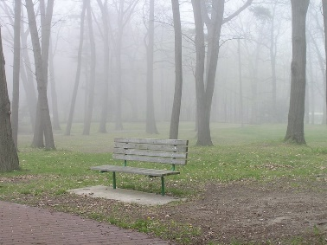
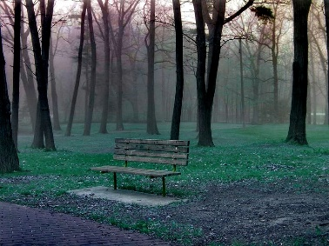
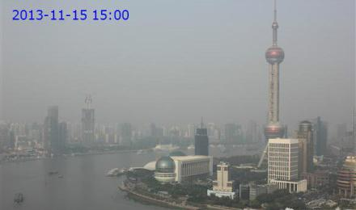
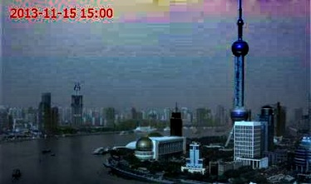
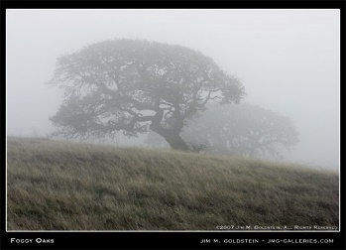
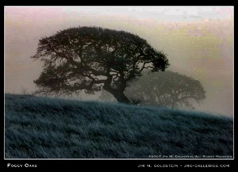
Results and Analysis
Test Results - System Outputs and Screenshots
Figure 1: Initial Output in Review 1
SL. NO | HAZE IMAGE | DEHAZE IMAGE
1
2
3
15

Slide 16
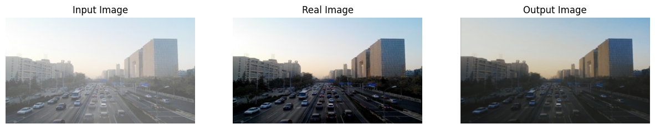
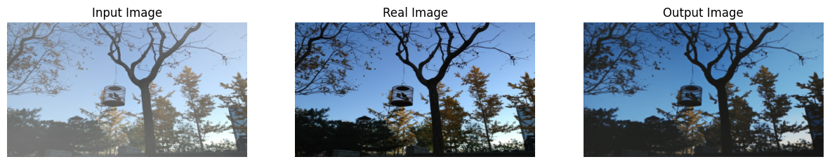
Contd…
Figure 2: (a) Input Image, (b) Real Image and (c) Output Image (dehazed) after Basic AOD Implementation
SL. NO | INPUT VS OUTPUT IMAGES
1
2
(a)
(b)
(c)
(a)
16
(b)
(c)

Slide 17
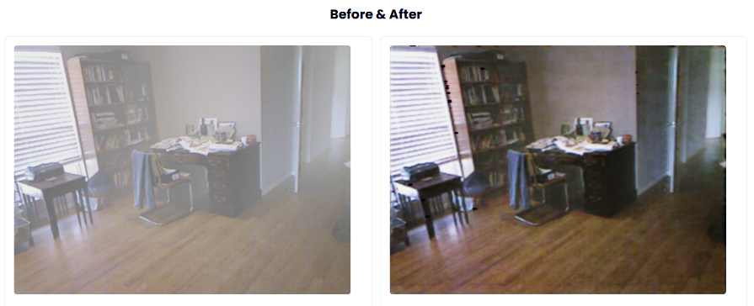
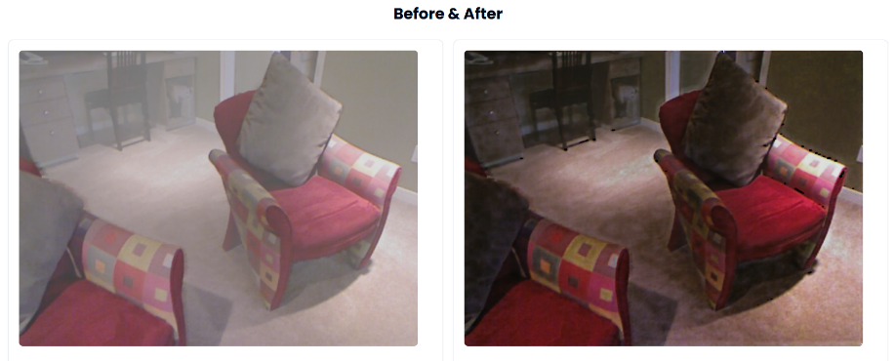
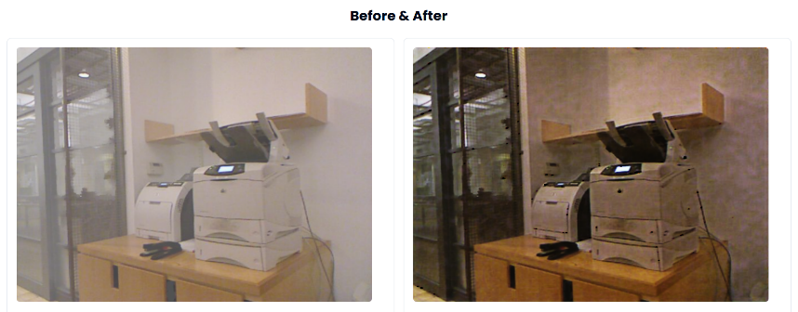
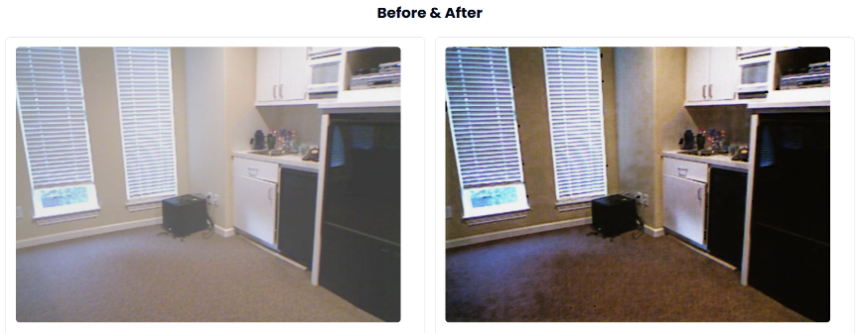
Contd…
Figure 3: Frontend Outputs With Improved AOD-Net Architecture Modifications
INPUT VS OUTPUT IMAGES
17

Slide 18

Contd…
STEP 1: This is the landing page where user can browse any hazy image to dehaze it.
18

Slide 19
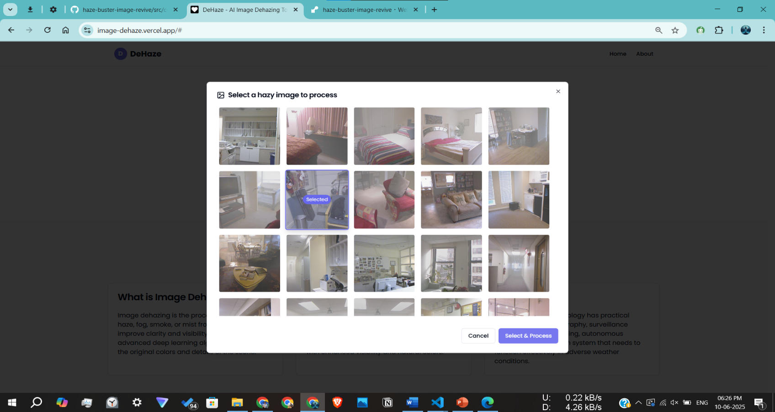
Contd…
STEP 2: A pop-up dialogue box appears consisting of several hazy image. User can select any image.
19

Slide 20
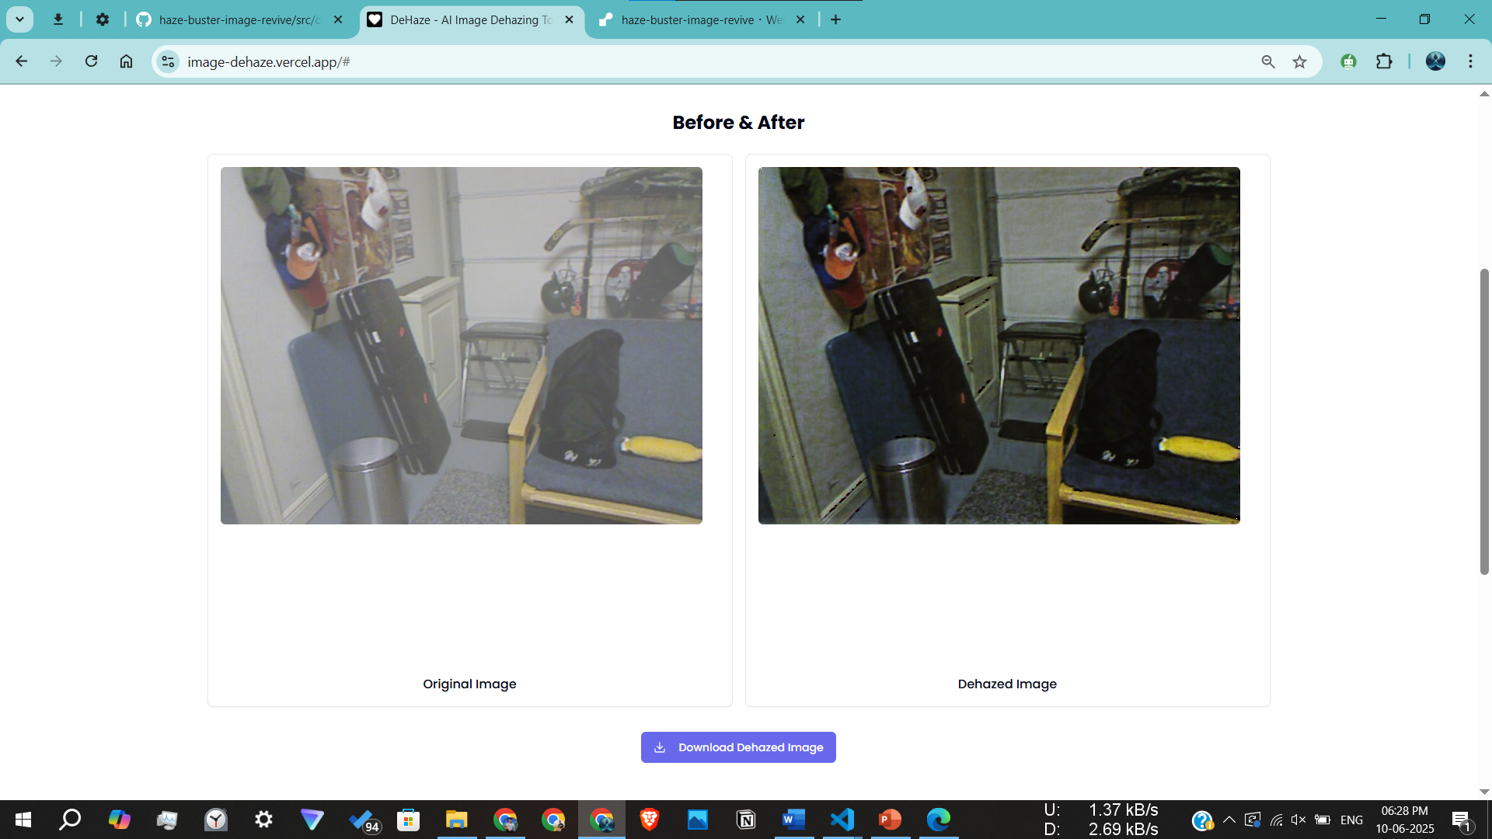
Contd…
STEP 3: The dehazed image is compared with the original hazy image.
20

Slide 21
Results and Analysis
Performance Metrics
Table 3: PSNR & SSIM Values
Methods | PSNR | SSIM
Dark Channel Prior | 41.361 | 0.54
Basic AOD Implementation | 49.686 | 0.69
Improved AOD-Net Architecture Modifications | 64.524 | 0.77
Interpretation of Results
The Dark Channel Prior method, while effective, produces lower PSNR and SSIM values, indicating more residual haze and degraded quality in the output images.
Our improved AOD-Net model with perceptual loss optimization, consistently produced higher PSNR and SSIM values, indicating better haze removal and image quality.
The implementation of Normalization during preprocessing ensures consistent input range across images, improving model stability and generalization.
21

Slide 22
Conclusion & Future Work
Key Findings
This project aims to develop a real-time image dehazing solution using a lightweight hybrid CNN, optimized with perceptual loss to enhance visual quality.
We have used AOD-Net Architecture in our model and trained on almost 13,000+ image pairs (approx. 80%) to get a wide exposure of complex and unique data patterns.
Incorporated perceptual loss optimization and metrics like PSNR & SSIM, to enhance dehazing quality. This helped in Enhanced Visual Clarity.
Integrated refinement blocks to preserve fine textures and object details often lost in traditional dehazing models.
Also used concepts like Normalization to have consistent outputs.
Scope for Improvement
This project/research can be incorporated in further mobile application, automobile, surveillance etc.
22

Slide 23
Bibliography
[1] He, Kaiming, Jian Sun, and Xiaoou Tang. "Single Image Haze Removal Using Dark Channel Prior." IEEE Transactions on Pattern Analysis and Machine Intelligence, vol. 33, no. 12, (2010), pp. 2341-2353.
[2] Cai, Bolun, Xiangmin Xu, Kuiyuan Yang, et al. "DehazeNet: An End-to-End System for Single Image Haze Removal." IEEE Transactions on Image Processing, vol. 25, no. 11, (2016), pp. 5187-5198.
[3] Li, Boyi, Xiulian Peng, Zhangyang Wang, et al. "AOD-Net: All-in-One Dehazing Network." Proceedings of the IEEE International Conference on Computer Vision (ICCV), (2017), pp. 4770-4778.
[4] Qu, Yun, Yi Chen, Jingying Huang, et al. "Enhanced Pix2pix Dehazing Network." Proceedings of the IEEE Conference on Computer Vision and Pattern Recognition (CVPR), (2020), pp. 8160-8168.
23

Slide 24
Contd…
[5] Asha, C. S., Abu Bakr Siddiq, Razeem Akthar, M. Ragesh Rajan, and Shilpa Suresh. "ODD-Net: A Hybrid Deep Learning Architecture for Image Dehazing." Scientific Reports, vol. 13, no. 1, (2024), pp. 1-15.
[6] Ren, Wenqi, Si Liu, Hua Zhang, et al. "Single Image Dehazing via Multi-Scale Convolutional Neural Networks." Proceedings of the European Conference on Computer Vision (ECCV), (2023), pp. 154-169.
[7] Mehra, Aryan, Poonam Narang, and Mita Mandal. "TheiaNet: Towards Fast and Inexpensive CNN Design Choices for Image Dehazing." Journal of Visual Communication and Image Representation, vol. 77, (2023), 103137.
[8] Bianco, Simone, Claudio Cusano, and Raimondo Schettini. "High-Resolution Single Image Dehazing Using Encoder-Decoder Architecture." Journal of Imaging, vol. 4, no. 8, (2022), 98.
24

Slide 25

25

